Slide 1
Practice Lab:
This Practice Lab is dependent on Discussion Unit 7602, where most of the objects we create in this lab were introduced.
This Practice Lab is also dependent on Discussion Unit 7548/7549, where we learn how to compile, set up a Spark/Scala project structure, other.
This Practice Lab requires a working DSE system, with DSE Analytics enabled.
Because of the dependency on the "dse spark-submit" utility, this Practice Lab requires a ssh(C) prompt on at least one node operating DSE Analytics.
DSE Analytics, Machine Learning, Apriori Algorithm
Notes:
The goal of this Practice Lab is to run an Apriori analysis.

Slide 2
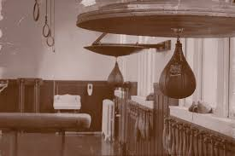
Challenge 1: Prerequisites
Prerequisites:
Instructions are provided for Linux
We will operate below recommended settings; 1 OS node only, minimum 8 GB RAM, 12 GB RAM preferred
That you have an operating single node DSE Analytics cluster.
All work done as ‘root’
You need to complete Practice Lab 7549 first, because we are going to re-use its project filesystem structure, other.
Notes:
To complete this Practice Lab, the following is assumed:
All prerequisites and conditions as listed above.
All work is expected to be executed on one OS node (instructions are written for Linux).
Because of resource constraints, it is expected you are running a single DSE Core node (no Graph, Yes Spark, Search) on this single OS node.

Slide 3

Working Goal:
From: Maury_Atwater
To: DSE_HOTSHOT
Subject: Need this now !!!
We need to start upselling ! CSV file; 10k orders, 43k items sold, 170 unique items, 4.4 items per transaction.
We need a set of association rules to apply on the Web site !
-MA
Maury Atwater, President of Atwater's
Notes:
The email above, lists our working goal.

Slide 4
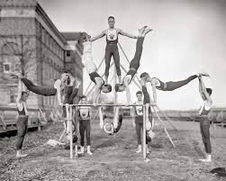
Challenge 1: Deliver Apriori
You are given the CSV source data file. Place this file in an easily spelled absolute pathname.
You are given the single Scala application source file, which is the Apriori application.
Let's save steps and time, and re-use the infrastructure from the 7548/7549 Practice Lab.
Save that original App.scala file to another location.
Overwrite the contents of App.scala with the Apriori source code.
Notes:
Complete the following:
The instructor will specify the location of two files you need in order to complete this lab.
Place the source CSV data file for this lab in an easily spelled complete pathname, with no hyphens or special characters anywhere in that path. (Possible Java issues.)
Copy the App.scala file from Practice Lab 7549 to a safe location; a location not under the parent project directory. (E.g., save the file to /tmp/, your home directory, other.)
Copy the contents of the Apriori application, into the original (newly empty) App.scala file.

Slide 5
Challenge 1: Compile and Run
From the my-app folder:
Compile via, mvn package
Run via,
dse spark-submit --class com.datastax.enablement.bootcamp.App target/my-app-1.0.jar
Notes:
Complete the following:
Compile and run just as before, just as we did in Practice Lab 7549.
Examine output, experiment with new data, other.
Master the Apriori.

Slide 6
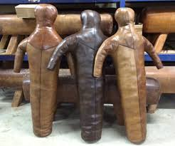
Challenge 2 (Optional): Same for Customer Churn
Save App.scala
Replace contents of App.scala with the single Customer Churn application code
Notes:
Complete the following:
Same as before; just as you pasted the Apriori application in the (original App.scala), now paste the Decision Tree Classification (customer churn) application inside App.scala.
Compile and run.

Slide 7
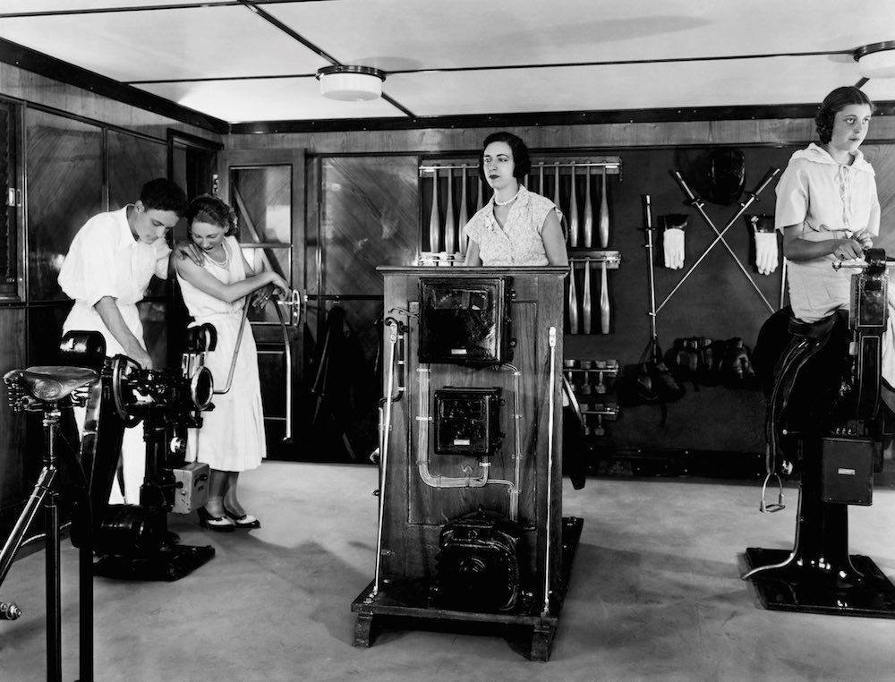
Challenge 3 (Optional): Clean Up
Using the instructions from Practice Lab 7549, actually instantiate two new project parent directories, so that we are not (cheating, and overwriting the contents of App.scala)
Compile and run all 3 programs; the original and the two new
Notes:
Complete the following:
That was a hack to save time; clean it up so that you can run all three applications.
Using Practice Lab 7549 (or just careful file copying), provide for the ability to run all three instances.

Slide 8
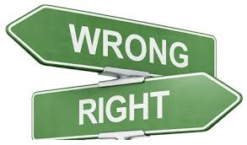
Practice Lab:
Lessons Learned
Notes:
Discuss what worked well, poorly, from the Practice Lab.

Slide 9
End of Unit:
Notes:
End of Practice Lab-

